Slide 1
Project PPT

Slide 2
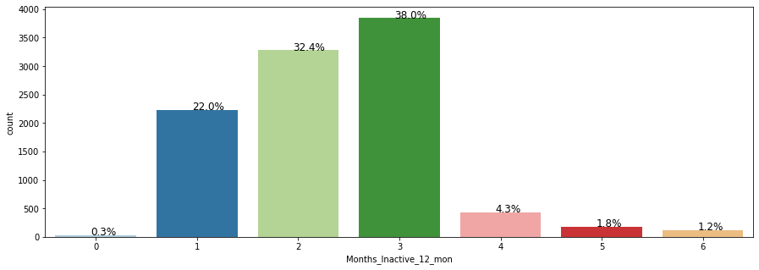
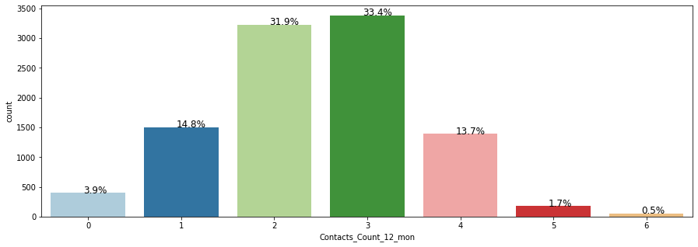

Slide 3

No scaling

Slide 4


First run

Slide 5



randomcv
Card cat
Dropping trans_ct

Slide 6
